Slide 1




AMBITIOUs
For all!
Notes:
I wanted to come here today and tell you a story. I wanted to try to make accessibility personal, something everyone here could relate to.
So I sat down to write a story.
Except, no one in my immediate family is differently-abled in a way that affects their relationship with technology. Everything I tried to write felt as though I were borrowing too heavily from someone else’s story.
So I needed another approach. I realized the way to make this personal, is to tell you why it’s personal to me.
I don’t care about accessibility because someone in my life needs it.

Slide 2
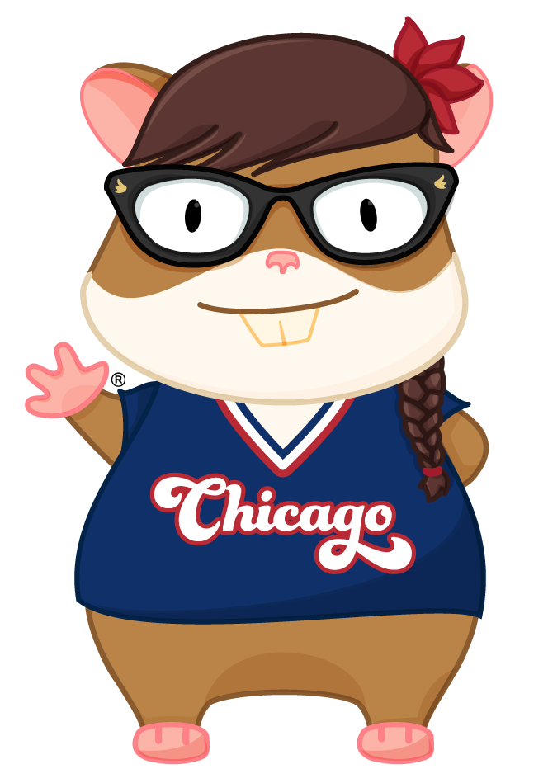
Hi there!!
Notes:
I care about accessibility because excellence is important to me, and accessibility is an essential part of crafting perfection.
I work for JP Morgan Chase, where we use Ember to build ambitious things. My team provides accessible UI components
through an Ember addon that other teams use to build corporate and investment banking applications.
We have a federal requirement to provide accessible products.
When I joined the team, we didn’t have very good guidance about how to make things accessible.
So guess what? I learned it!

Slide 3

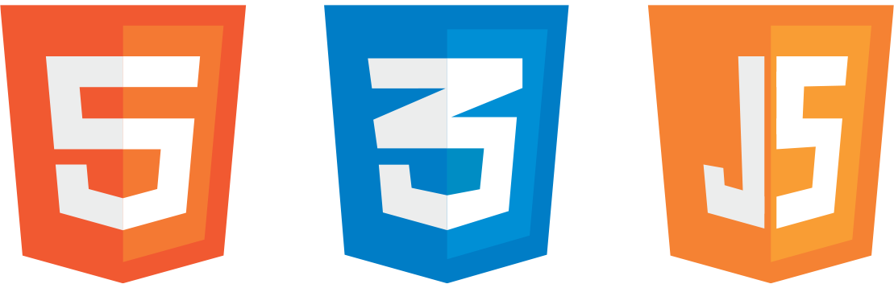
Web standards
Notes:
Over the last 22 years, I’ve discovered that the more I get to know web standards, the more clearly I can think about how to architect
a solution. I can build new things because I have existing context.

Slide 4
Web specifications
Wai-aria
Notes:
There are also accessibility standards- Accessible Rich Internet Applications
Or WAI-ARIA, for short.
References:
https://www.w3.org/TR/wai-aria/

Slide 5

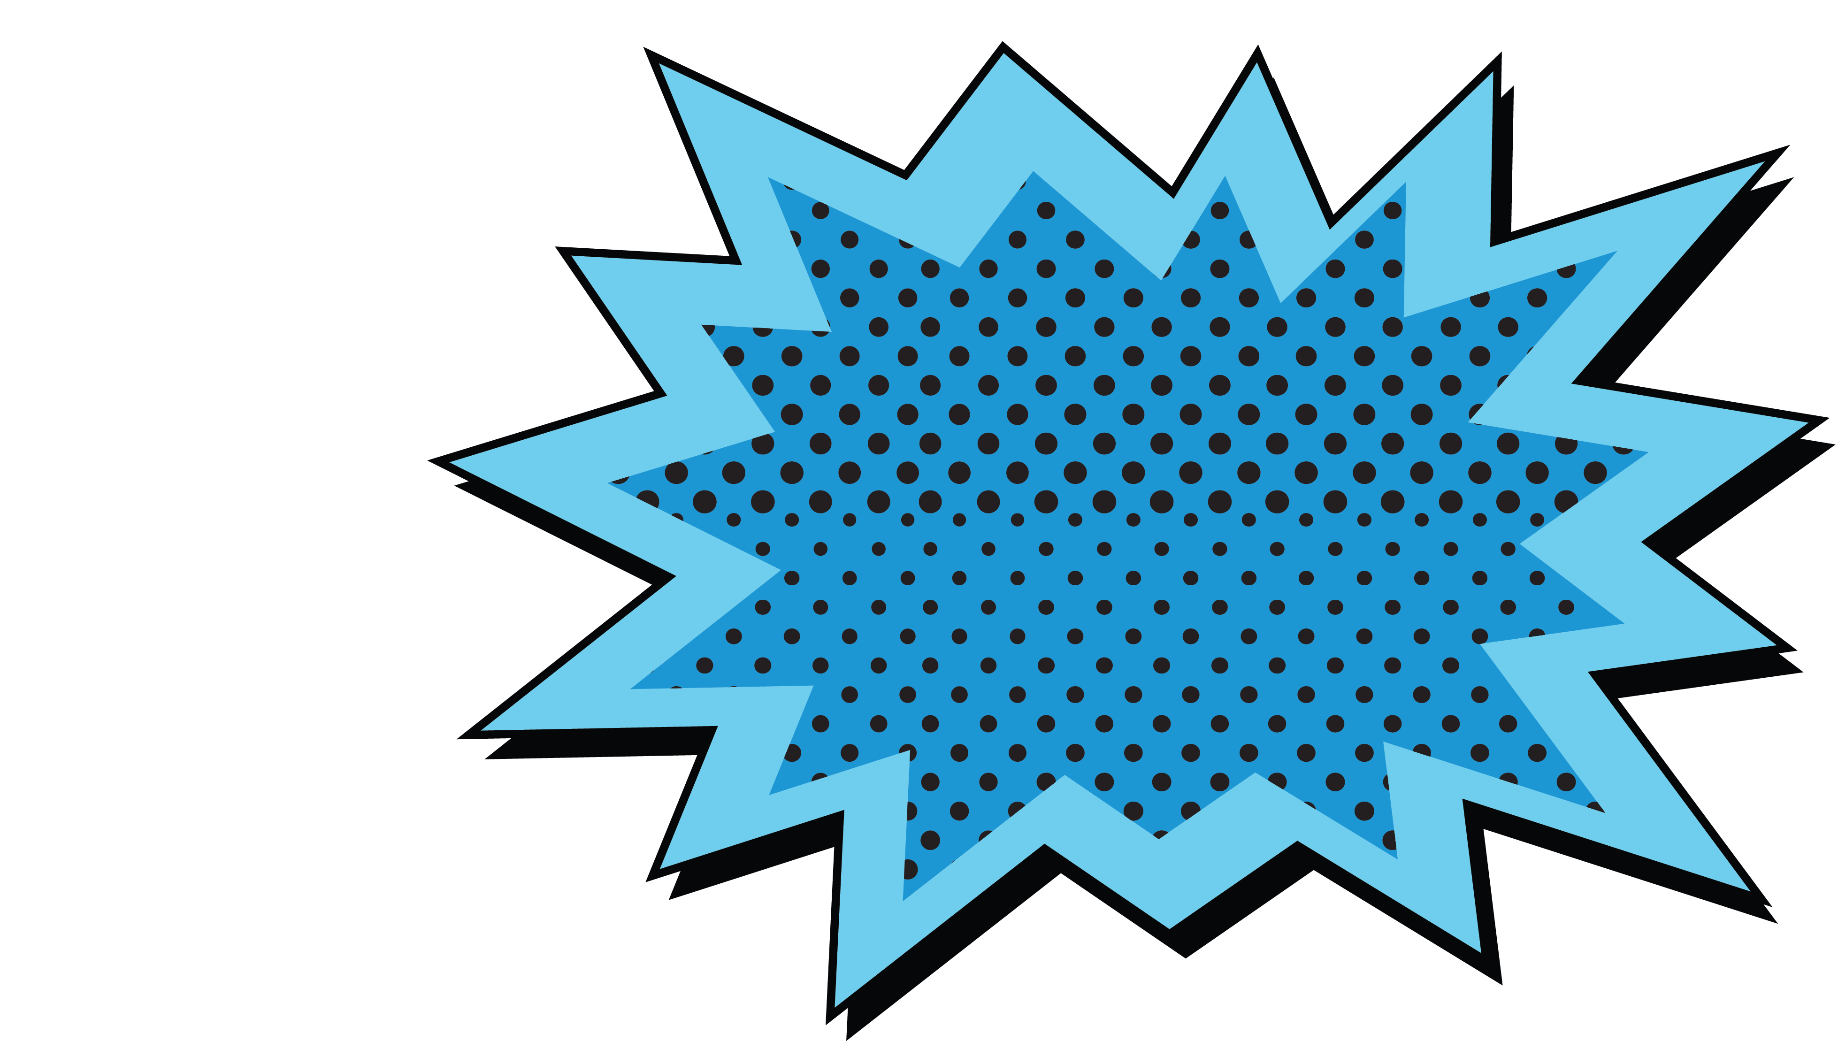
Quick! To the
batmobile!!
Notes:
Before we continue, let’s quickly review some other lingo you might commonly hear in the accessibility space.

Slide 6


What Is Accessibility?
Notes:
Accessibility is the practice of making your websites usable by as many people as possible
Can users of all ability levels use my application in the way it was designed and intended to be used?

Slide 7

Web content accessibility guidelines
Notes:
Another common term is
Web Content Accessibility Guidelines, or

Slide 8

WCAG 2.0
A
AA
AAA
Notes:
WCAG, for short
WCAG is currently on recommendation version 2.0.
There are three levels- A, AA and AAA
A is the bare minimum for everything.
If you have a legal requirement to provide an accessible
product, AA is typically the level of accessibility you will need
to provide. It includes A and extends to be more accessible.
AAA is the most strict level of accessibility, and typically
relates to things like the reading level of your content and
the color contrast requirements are higher. I have typically
seen this with educational products or government websites
that provide a service.

Slide 9
Americans with Disabilities Act
Notes:
The Americans with Disabilities act is often referred to as

Slide 10
ADA
Notes:
ADA
Other countries like Australia, Portugal, Canada and the UK
have similar laws.

Slide 11
#A11y
Notes:
If you’re one of my twitter followers, you will see me use this
hashtag a lot!
If you look at the word ‘accessibility’ you will see that there
are 11 letters between the ‘A’ and the ‘y’ - hence “A-eleven-Y.”

Slide 12
the future
Is now!!
Notes:
One thing that really inspires me to keep doing work in the
accessibility space is that the future is now!!
There have been a lot of really great advancements in
assistive technology in the last few years- let’s look at some
of them.

Slide 13

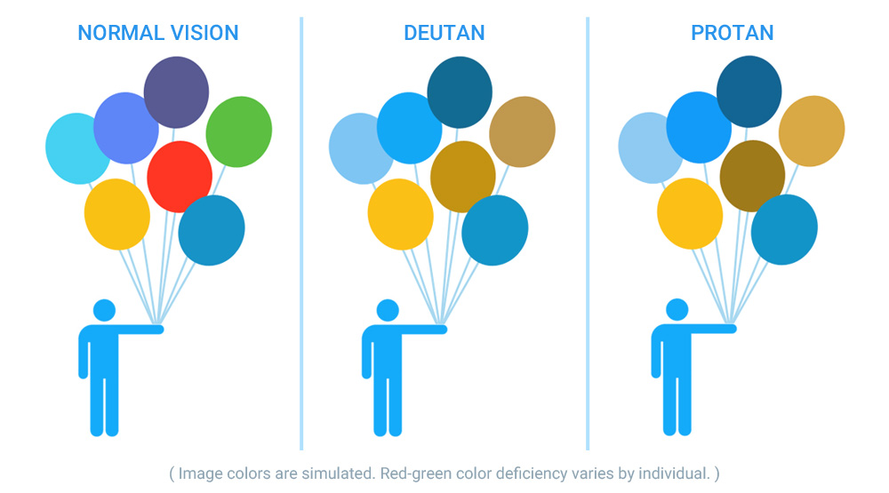
See color!!
Notes:
EnChroma glasses give color-blind people the ability to see color- did you know that there are an estimated 300 million people in the world with a color vision deficiency? Did you also know that many people with color blindness cannot tell that the power connector on a MacBook changes color? Did you know that people who experience color-blindness are often surprised to learn that peanut butter is not green?

Slide 14


Give hearing!!
(Auditory brain stem implant surgery that gave a three year old boy the ability to hear for the first time.)
Notes:
Doctors at the UNC School of Medicine in Chapel Hill
performed the first auditory brain stem implant surgery,
which gave a deaf child back his hearing. This is a photo of
the moment when he heard his father’s voice for the first
time.

Slide 15
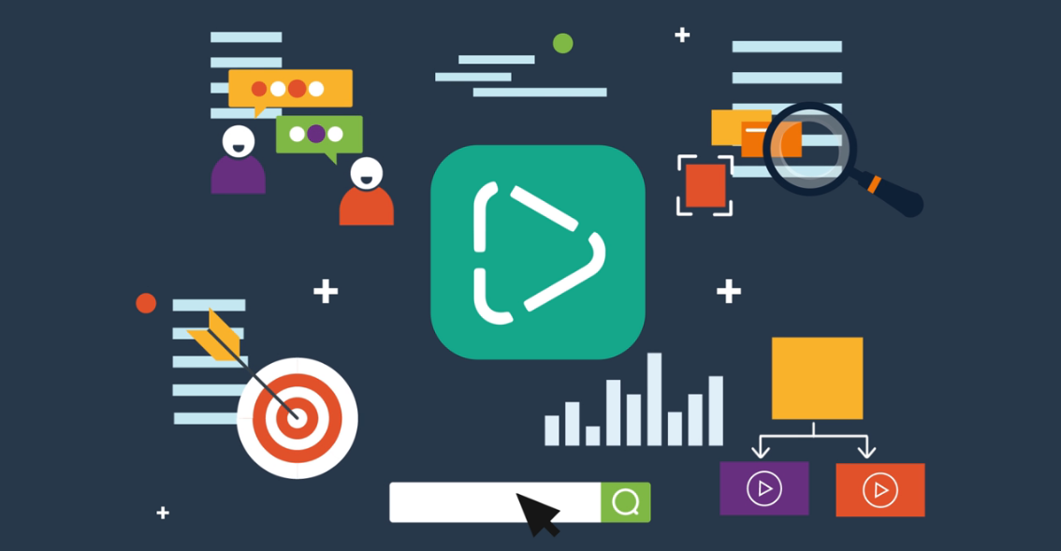
Adapt content!!
Notes:
Microsoft has developed a cloud service called Video Indexer
- It can provide transcriptions, and extract text that appears in video that isn’t spoken
- It can translate to different languages
- It can analyze the sentiment
- Separate background noise and voice activity, providing clearer spoken word
- Even adjust the language model used for transcription – making it industry or market specific. This means you could
make your content more accessible to viewers who haven’t had as much access to education.

Slide 16
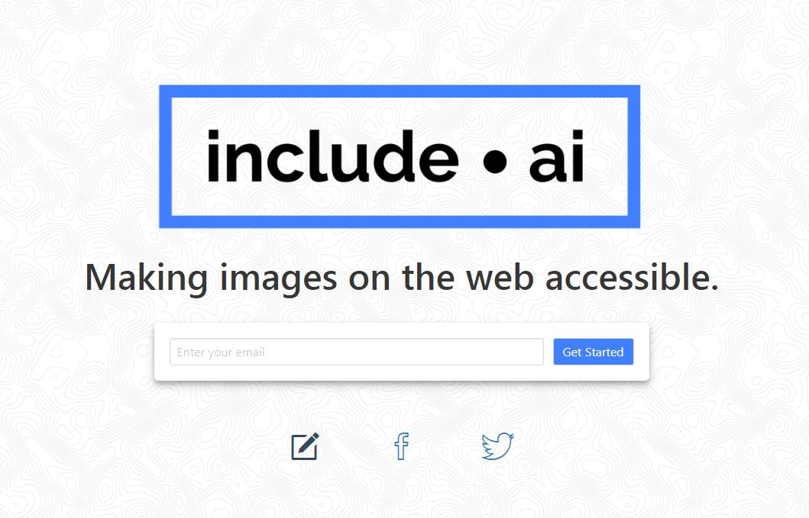
Image descriptions!
Notes:
Include.ai is a project started by a student at Stanford, whose goal is to give his father – and all people who are blind - better access to image descriptions on the internet.

Slide 17
What will you create?
Notes:
What about you? What will you create?
Brilliant, creative minds are in this room, each of you with the potential to solve hard problems in ambitious ways.
When I see these advances in technology, I am inspired.
I feel empowered to be curious.
I feel determined to

Slide 18
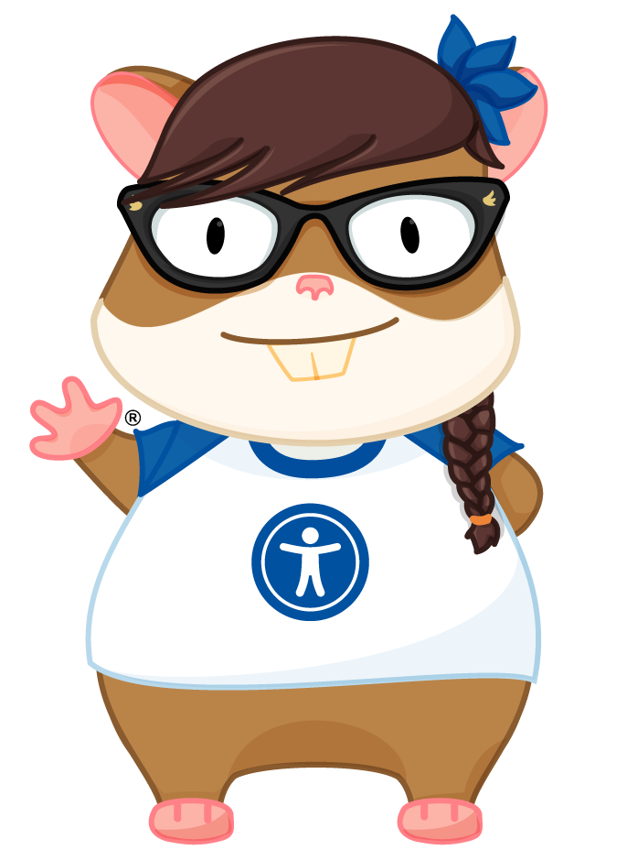
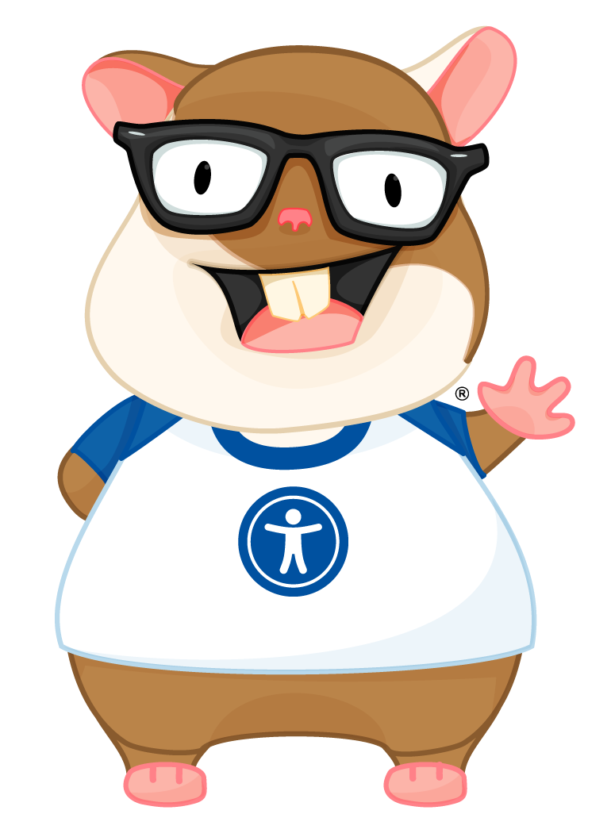
Ember-a11y project
Notes:
Even in our own community there is innovation in how we provide accessible solutions. I’m absolutely delighted to be able to introduce you all to the official Ember-A11y Zoey and Tomster, thanks to the incredibly talented Lindsey Wilson. To me, these represent a tangible commitment to building accessible things in Ember.
-----------------
My friend Jetta says- “In order to show up big, you have to be big.” Jetta is a force to be reckoned with, and I find it a wise move to listen when she talks.
So let’s be big.

Slide 19

accessibility
Is emotional
Notes:
So, we’ll go over accessibility in Ember and Ember addons in a minute, but I think it’s important for us to first talk about something else, some of the things that are hard about accessibility.
If we want to solve the hard things, we need to be willing to face the hard things, and directly acknowledge some of the reasons we might ignore them.

Slide 20

Our users...
But I can’t
Find the login
Fields on the
website!
I need to check my
bank balance &
pay my bills…
Notes:
It’s emotional for our users, who need to perform tasks on the web to get through their daily lives.

Slide 21

Our users...
But this site
Doesn’t seem
To have any
“buy” buttons!
I wanted to buy
A present for
My nephew!
Notes:
It’s emotional for our users who wanted to buy a present for a family member but the content isn’t machine readable, and they can’t properly navigate through the site.

Slide 22


Our users...
Why don’t they care?
Notes:
It’s emotional for our users because it makes them feel frustrated – they can use some sites but not others, which tells them that it is possible. It makes them feel even more isolated, because developers actively chose to make a product that they are unable to use.

Slide 23
Developers...
My Project
Manager will be
Upset if I don’t
Finish this now!
My team lead
Said to ship it
Now, and we’ll
Fix it later!
Notes:
Accessibility is emotional for developers, too.
- We’re under pressure to finish projects that have been promised at an unrealistic timeline
- We’re being told to “ship it now and fix it later” – but is there really ever a “later”?
Are we failing our users when we fail to be the technical experts we were hired to be?

Slide 24
Developers...
I have to
prove That I’m a
Ninjarockstarunicorn!
Notes:
Or maybe it’s that we feel pressure to prove ourselves.
Has anyone here felt the pressure to prove themselves? I know I have.

Slide 25

Notes:
Under the weight of all this, it’s no wonder that accessibility is emotional.

Slide 26
accessibility
Is hard!
Notes:
Accessibility can also be difficult to get correct when you’re
first starting out.

Slide 27
Hard problems!
Route transitions
Modals
aria-* attribute support
Click all the things!
Passwords
Notes:
We will all have things that we think are the hardest to do,
but this is my list of “top five hard a11y things that I’d like to
see permanently solved in Ember”
- Route transitions. I think it’s incredible, the way Ember
handles routing….but one of the downsides is that when the
route changes, nothing is announced to the screen reader
other than a link being clicked. If you have to depend on only
on what the screen reader is telling you, you’d have no way
to know that the link did what it was supposed to do. Andthis
isn’t just an issue with Ember, it’s an issue with all SPAs
out of the box.
- Modals that insert themselves correctly into the DOM, have
the correct roles, and most importantly, trap focus!
Plus, there’s a difference between visible focus and screen
28
reader focus.
- ARIA attribute support- there’s a specific set of rules for
what things should have labels or descriptions, and what roles
should be on what element in specific context. Of course, now
that I think about it, it IS a specific set of rules…and we’re
engineers and we like rules….hmmm…. …maybe we *could*
engineer for this….
- You can add an action to anything. This is awesome. This
also not awesome, because it’s not just the click that you
need. If you can click on it, you also need to be able to
interact with it via keyboard. A screen reader needs a machine
readable name for what kind of interactive element it is,
because that tells the person with assistive technology what
to expect, or what to *do* with it.
- An interactive element also cannot contain another
interactive element.
- So this one is a bit messy, turns out. I wonder if we could
improve this?
- Passwords are hard but they’re not just hard in Emberthey’re
hard everywhere. Have you ever tried to fill in a
password with a screen reader turned on, while not looking at
the screen? I’ll give you a hint… “star, star, star, star, star, star….”
How do you ensure privacy but still provide an inclusive
experience? I wonder if this is an area where we need to look
differently at the problem.

Slide 28


Slide 29




The “Easy” wins!!
Use html5
Link vs. button
Keyboard navigation
Color contrast checks

Slide 30
Developers...
“Tabs vs spaces, fight me.”

Slide 31





Slide 32
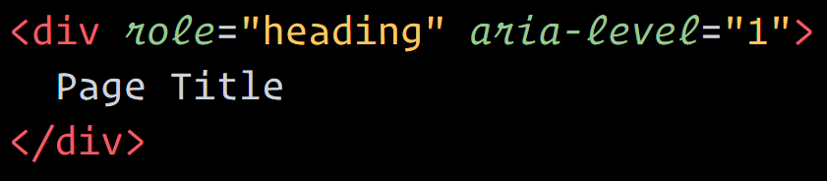

Developers...
“This is fine.”

Slide 33
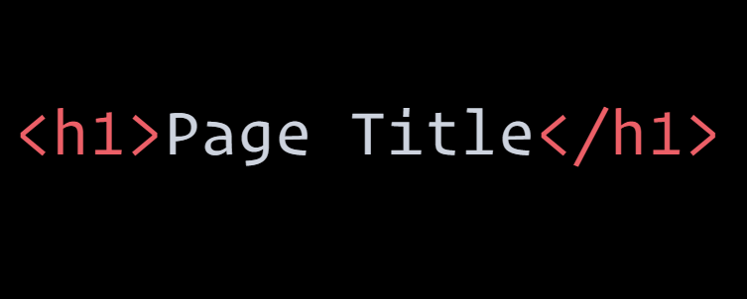

Developers...
Okay,
But…

Slide 34
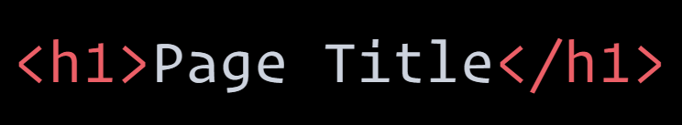
Developers...
Is it tho?
Notes:
So which one is easier?

Slide 35


Slide 36
Ember addons!!
Ember-a11y
A11y-announcer
Ember-a11y-testing
Ember-a11y-landmarks
Ember-component-attributes

Slide 37


be
magnanimous

Slide 38
Magnanimously solve
the same list as hard problems

Slide 39

get
involved

Slide 40


Thank you!!
@melsumner
@melaniersumner

